Slide 1

BC2410, Prescriptive Analytics From Data to Decisions
A Brief Review of Lecture 11

Slide 2
On Group Project Presentation
Each group has 20 mins (15 min presentation + 5 min Q & A)
Presentation accounts for 10 marks for each of you
Assessed by your classmates (40%) and me (60%)
Each group submits the grades to NTULearn

Slide 3
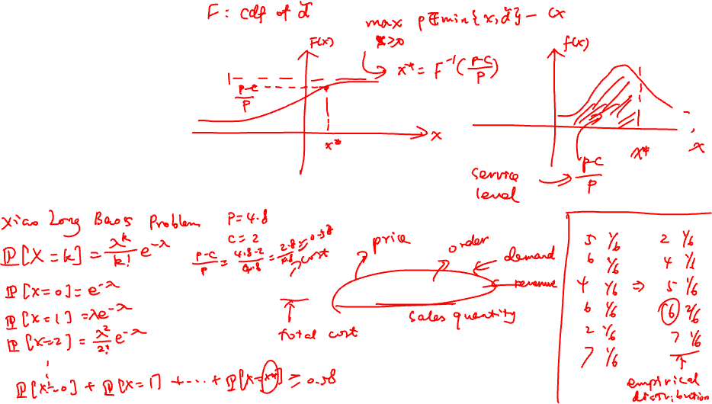
A Newsvendor Problem
Buy x items at cost c
Items sold at price p
Salvage price is zero
Uncertain demand, hence profit is uncertain

Slide 4
